Slide 2
Who is this?

Slide 3
Wilfrid Laurier (1841-1919)
Liberal
Political philosophy
Rooted in ideas of freedom and equality
Support for fair elections, free trade, freedom of religion & civil rights
Conservatives prefer tradition and keeping things the same = no big policy shifts

Slide 4
1896 - 1911
Manitoba Schools Question (1896/7)
Recruited immigrants to the West
Boer War (1899 – 1902)
Funded the Canadian Northern Railway and Grand Trunk Pacific Railway
Alaska Boundary Dispute (1903)
Created Saskatchewan and Alberta (1905)
Naval Services Act (1910)

Slide 5
French Canadian
1st French Canadian PM
Favoured strongly by the people of Quebec
French Canadians hoped he would strengthen the rights of the French language and culture
Bilingual
Hopes to satisfy everyone

Slide 6
National Unity
Laurier wanted a strong, united Canada
Difficult to achieve at this time. Why?
Louis Riel
Red River Rebellion
Manitoba Schools Act
British Imperialism

Slide 7
What is Imperialism? (Concept #1)
The policy of one nation acquiring, controlling or dominating another country
= British control of Canadian colony
Under the control of the Queen (Governor General in Canada)
British Empire was vast – the sun never sets…

Slide 9
English Canadians felt strong ties – French Canadians did not
This was cause for conflict
Laurier wanted to promote autonomy
BUT, what about the immigrants from other countries? Who did they side with?

Slide 10
Canada: A People’s History – Episode 11

Slide 11
Compromise (Concept #2)
Boer War (1899 – 1902)
Diamonds and Gold found in South Africa
Dutch settlers “Boers” fought Brits for decades
British battle for land - $$$
Called on colonies for help

Slide 12
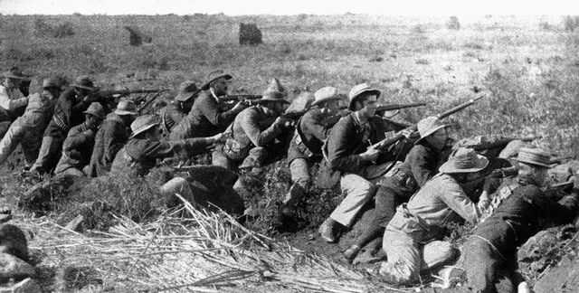
English Canadians strongly support the British invasion
French Canadians see the was as ‘unjust’ – a waste of Canadian lives and money
What does Laurier decide to do?

Slide 13
Laurier’s compromise #1
With the English and French at odds, Laurier decides:
Volunteers only
Provide equipment and transport to South Africa
After that, soldiers at the cost of the British
Canada sent over 7300 troops to South Africa
270 died in the course of the war

Slide 14
Naval Service Act (1910)
German navy was notably gaining strength
The British needed to act
Asked colonies for money to build a bigger and stronger navy (dreadnoughts)
Laurier wasn’t sure what to do:
Support the pro-imperialists?
Support the anti-imperialists?
Something else entirely?

Slide 15
Compromise #2
Builds Canada’s own Navy
Five cruisers & six destroyers
In the event of war it would be placed under British command
Naval Service Act – passed 1910
Nobody was happy! Why?

Slide 16
Created Canada’s “tin-pot” navy
English Canadians did not think this was enough support for the British
French Canadians despised the imperialist link

Slide 17
Did Laurier’s compromises help or hinder the quest for “national unity”?

