Slide 1
I lost my talk: poetry
Tove, Brad, and Danie

Slide 2
Introductions
Who are we?
What are we going to learn?
What do you already know?
Remember: Art is subjective and is the creative and personal expression- people experience art in their own unique way

Slide 3
Why people write poetry:
The release of inner feelings is a well-documented therapy and language is one our best tools for self-expression
We write poetry to release what we cannot say but write, we write what our minds can't understand ,
Can be used as a coping mechanism
Maya Angelou warns, “there is no greater agony than bearing an untold story inside you.”

Slide 4
Groups
In your groups:
- get out a piece of paper
- write one sentence of a poem and pass to your left
- read the other sentences and add a line to others’ poems
- once finished share your poems with the group

Slide 5
Sharing time

Slide 6
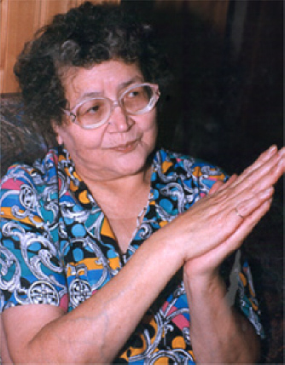
Rita Joe
Rita Joe (née Rita Bernard) Rita Joe was born and spent her childhood on a Mi'kmaq Reserve at Whycocomagh on Cape Breton Island.
Rita Joe later returned to Cape Breton to live on the Eskasoni First Nations Reserve, where she and her husband raised 10 children, including 2 adopted sons.
She lived with foster families after her mother's death when she was just 5 years old. Orphaned when she was 10, Rita Joe left the island at the age of 12 to go to the Shubenacadie Indian Residential School on mainland Nova Scotia.

Slide 7
I Lost My Talk
Lost My Talk
I lost my talk
The talk you took away.
When I was a little girl
At Shubenacadie school.
You snatched it away:
I speak like you
I think like you
I create like you
The scrambled ballad, about my world.
Two ways I talk
Both ways I say,
Your way is more powerful.
So gently I offer my hand and ask,
Let me find my talk
So I can teach you about me.
Rita Joe

Slide 8
Group Discussion:
How do you interpret Rita Joe’s poem?
Why do you think she may have written this?

Slide 9
Group poetry discussion:
What is the poet trying to describe in this poem?
What are some of the feelings you can detect?
3. Does the author use any imagery to show their point of view?
4. Are there parts of this poem which you can connect to in your own life?

Slide 10
Inner poet:
Tap into your inner creative being and write a poem about your feelings about the topics the poems touched upon
Do not write your name on your paper

Slide 11
Share:
What do you think the author is trying to say?
How does this poem make you feel?

Slide 12
Poetry
Language (and literature in particular) is a mirror of our world. It captures and reflects some of the deepest human emotions. Language is one of our most carefully crafted tools, a tool that we continue to reinvent, sharpen and expand in order to better express ourselves. And, since language is designed entirely around our needs of expression, it is arguably the best way to examine human life and ultimately connect with ourselves.

Slide 13
Final Thought:
"My greatest wish is that there will be more writing from my people, and that our children will read it. I have said again and again that our history would be different if it had been expressed by us.“
-Rita Joe

