Slide 1
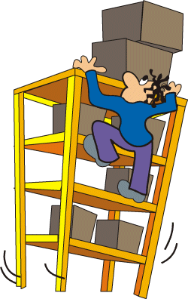
Safety in our Schools

Slide 2
Video for Thought

Slide 3
Definition of School Safety
“School safety encompasses a concise plan to prevent and respond to threats of danger, natural disasters, violent criminal acts and any event that places faculty, staff and students at risk”

Slide 4
School Emergency Action Plans
Get in groups and create an emergency action plan for either: Earthquake, Fire or a school Lockout and what contents you would carry in your First Aid Kit.

Slide 5
Duotang contents: Specific to room in building
First aid contents
Student medical alerts with pictures
Class lists
Fire Drill Procedure
Earth Quake Procedure
Lockdown Procedure
School Map

Slide 6
Lockout procedure: Greater Victoria
Do not approach or intervene if weapon involved
Do not activate any alarms
Do not leave school until directed
Administrator or Police decide when to lockout
Call 911
Use PA to broadcast signal and turn off bells
Secure room: Call students into room, lock or barricade door, close blinds, if student knocks you can let them in K-5 schools only
Non-secure room: Mark safe areas, hide, duck, crouch to not be seen, equipment room, bathroom stall etc.

Slide 7
Earthquake EAP
Duck, cover and hold 60 seconds, stay for 60 more seconds.
Admin will announce when it is safe to vacate school
If stuck in room place red HELP sign in window
Exit to safety meeting spot: arrange students, roll call, report injured or missing names, attend to those students.

Slide 8
Fire Drill EAP
Sound the fire alarm
Dial 9-1-1 : state name, address, where is the fire exactly, what floor, how fast is it spreading, are people trapped?
Leave the building by nearest exit. If possible close doors and windows to keep contained.
Meet in safety area.
When you hear alarm: supervise and line them up, leave building, walk don’t run, keep yourslef and kids calm. DO NOT RE-ENTER for any reason.
Go to designated safety area.

Slide 9
How do we reduce safety risks and have everyone feel protected?
Report anything you consider a threat.
Set school norms and rules surrounding safe behavior.
Communicate procedures with kids, staff, parents.
Learn and teach how to recognize warning signs.
Use school resources when someone is in trouble. i.e. councilor

Slide 10
Are some of my students potential risks to the schools safety?
Things to consider:
Lack of interest and absences
Refuses to follow rules
Are they obsessed with talk surrounding violence?
Self isolation
Content of writing?
Past incidences (have they brought a weapon to school?)

Slide 11
After we diagnose signs how do we go about it?
Talk to Student?
Talk to Principal and Vice Principal?
Talk to Parents?
Do we have to alert police? How serious is the threat?

Slide 12
When do we have time to teach safe behavior?
Assemblies, as a prevention method not once a problem occurs.
Invite guest speakers to school
CAPP classes or home room.
Programs after school or before school.

Slide 13
DEBATE/DISCUSSION
Should we as teachers/schools be preparing students for violence like we prepare for fires and earthquakes?

Slide 14
Questions to think about
Why do you think violence occurs in schools?
Why might there have been a large number of gun related violent incidents in schools?
Do you feel there is a relationship with music and video games violence and school violence?

