Slide 1
Immigration
1. Identify the key players of the immigration policy
2. Understand the reasons why there was immigration to the “last best west”
3. Understand and identify push-pull factors from various countries

Slide 2
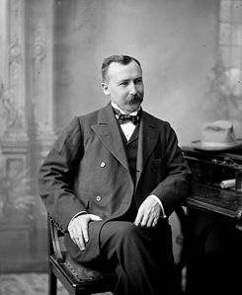
Clifford Sifton
Minister of the Interior
Ran a massive immigration program to settle the West
Had offices in Europe & USA
Tried to keep out “undesirables”
Blacks, Jews, Asians
Examples of prejudice

Slide 3
"I think that a stalwart peasant in a sheepskin coat, born to the soil, whose forefathers have been farmers for ten generations, with a stout wife and a half dozen children, is good quality“
- Clifford Sifton

Slide 4
Why does Canada need immigrants?
1891 population = 4.83million
1921 population = 8.79million
Laurier (remember him?) thought that more people meant more money for Canada
Lots of empty land – resource?
Try to become a world power

Slide 5
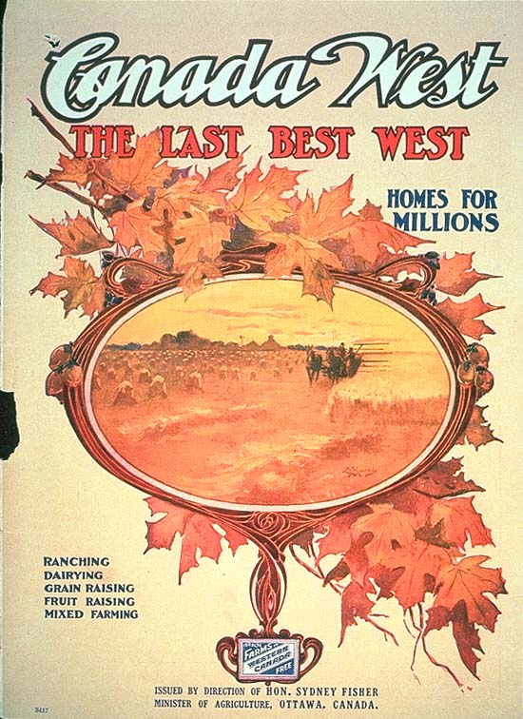
The power of advertising

Slide 6
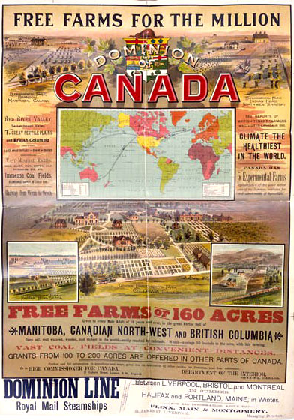
Advertise free land
“Homes for millions”
Pictures
“Canada is the
Twentieth century”
$$$

Slide 7
Homesteading
¼ of 160 acres per family
Typically farming
Self-sufficient
Hard work to make land farmable
Needed to work until own lands floruish
Required animals, a plow, housing
Soddie, dirt floor, thatch roof

Slide 8
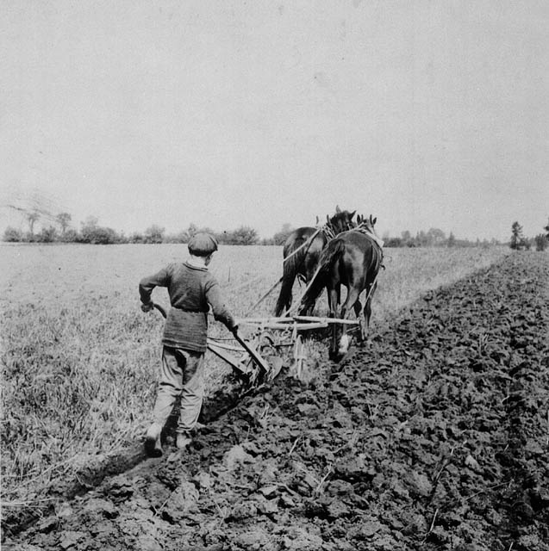
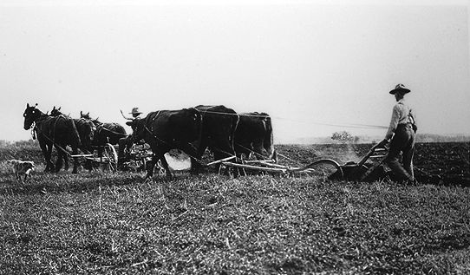
Open-door policy
No restrictions on immigrants
Encouraged eastern Europeans – why?

Slide 9
Who came to Canada?
Russians - Doukhobors
Poles
Ukrainians
Americans
British – 1/3 of immigrants
WHY CANADA?

Slide 10
A need to leave one’s country
An attraction or opportunity elsewhere
Work in harmony
Called push-pull factors
Still present today… examples?

Slide 11
What factors?
Overcrowding Free land
Poverty Gold rush
Famine Resources
No land Jobs

Slide 13
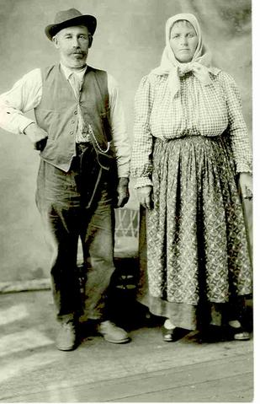
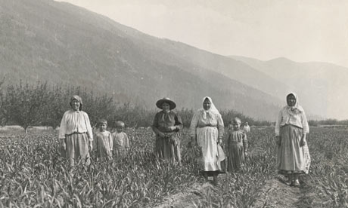
Another possibility:
Religious persecution
i.e. Doukhobors
Military – ¾ million acres – 7000

